Slide 1
Technical Communication Module 1 - Grammar
S.V. Kulkarni
EE Dept, IIT Bombay

Slide 2
Types of Technical Communication
Monographs/ books
Journal publications
Letters
Conference publications
Technical reports
Patents
Online tutorials, lectures, demonstrations and blogs
Effective Technical Communication
Correct grammar
Clarity of thoughts
Concise and non-repetitive
Understandable and reproducible by readers
Novelty/ practical value
Notes:
2

Slide 3
Grammar
Parts of speech
Correct use of articles
Active/ passive voice, types of tenses
Punctuation
Common mistakes
Two tutorials
Reference: Wren and Martin ‘High School English Grammar’
Notes:
3

Slide 4



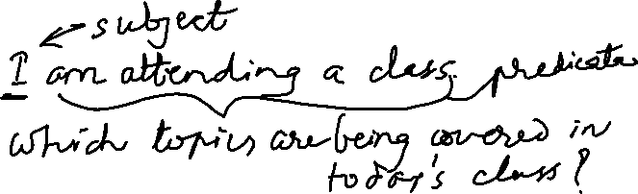


Parts of Speech
Sentence: A group of words – makes complete sense
Statement
Question
Command/ request
Exclamation
Sentence: Subject and predicate
Notes:
4

Slide 5
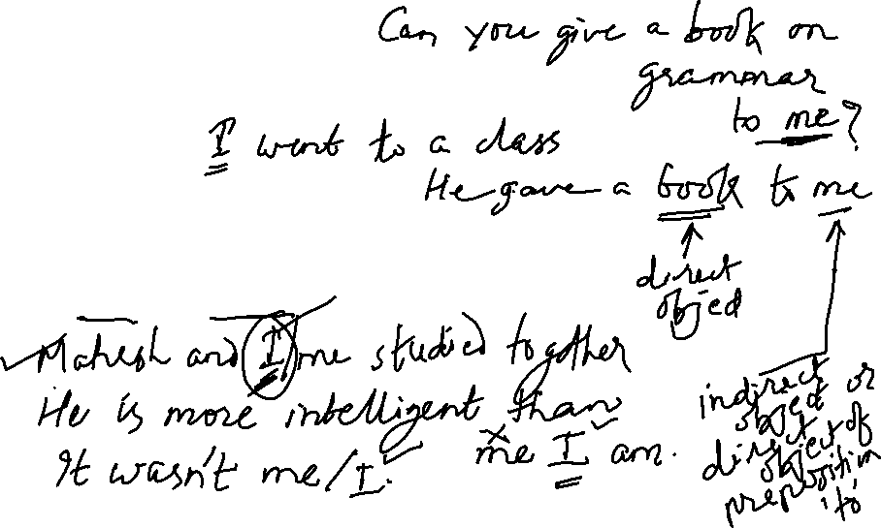
Subject and object
Correct use of “I” and “me”
Direct and indirect objects
Notes:
5

Slide 6






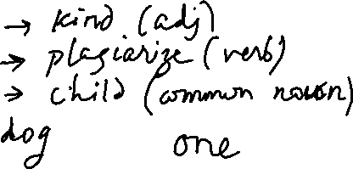

Words
1. Nouns
Proper
Common
Collective
Abstract
Countable
Uncountable
Notes:
6

Slide 7
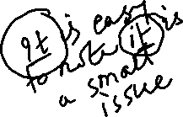


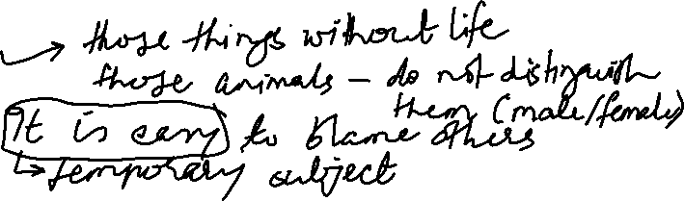


Words
2. Pronouns
Personal pronouns: first person, second person, and third person
Use of “it”
Notes:
7

Slide 8









Words
2. Pronouns
Reflective
Emphatic
Demonstrative
Indefinite
Distributive
Relative
Use of “it”
Notes:
8

Slide 9



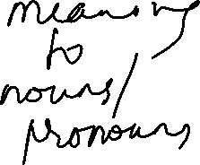
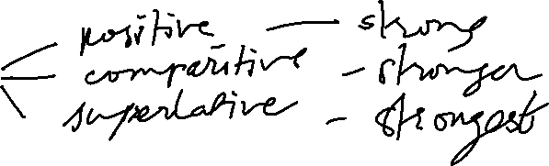

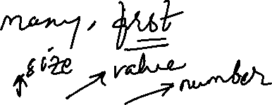

Words
3. Adjectives:
Quantity
Quality
Number
When to use big/ high / large few/ a few
Degrees
Notes:
9

Slide 10





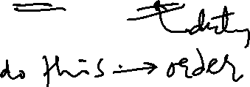


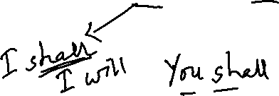

Words
4. Verbs
Ordinary
Modal auxiliary verbs
When to use can/ could/ may/ might
shall/ should/ will/ would/ must/ ought
Notes:
10

Slide 11
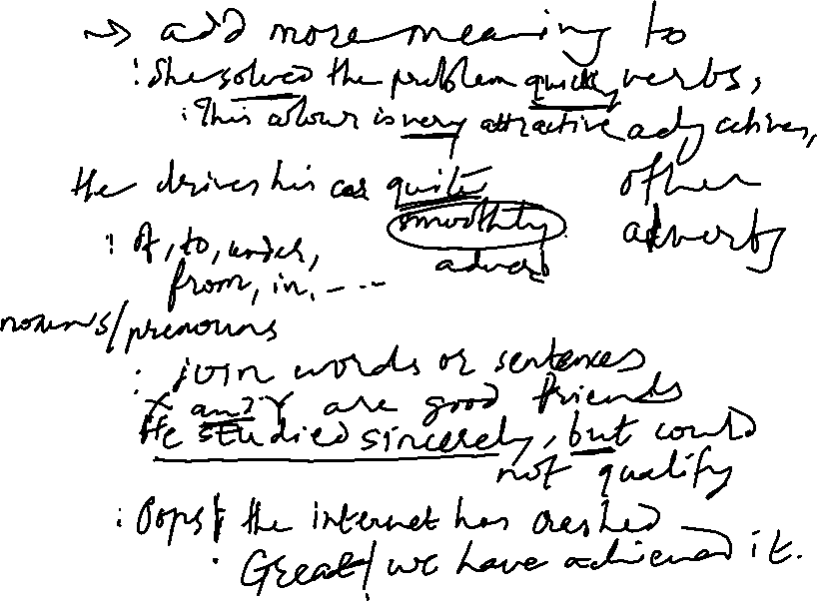

Words
5. Adverbs
With verbs
With adjectives
With other adverbs
6. Prepositions
7. Conjunctions
8. Interjections
Notes:
11

Slide 12
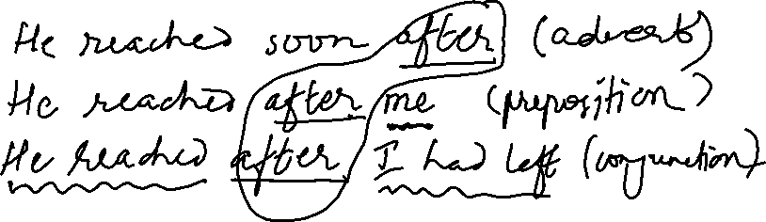
Words
The same word used for different purposes:
Notes:
12

Slide 13





Articles
Indefinite article:
Definite article:
Notes:
13

